Slide 1

skin

Slide 2
Malware
- short for Malicious Software
- includes viruses, worms, ransomwares and trojans
- understanding the type of malware
-

Slide 3
Real example of Malware
Real example of Malware
Real example of Malware
Real example of Malware
Real example of Malware

Slide 4
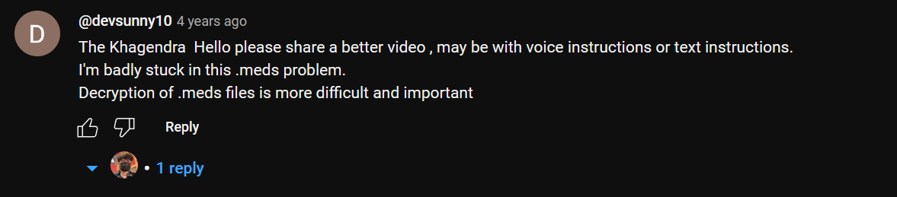
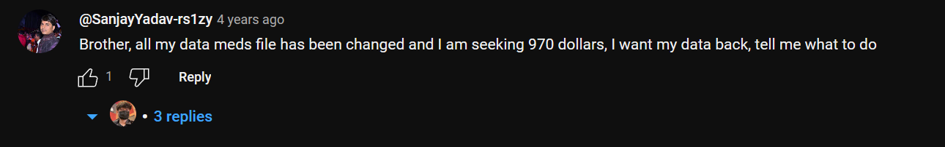
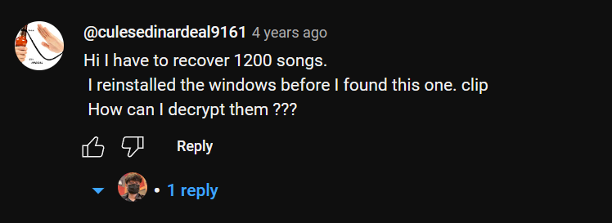
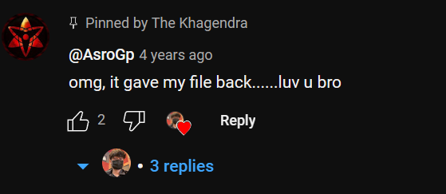

Slide 5
Social engineering

Slide 6
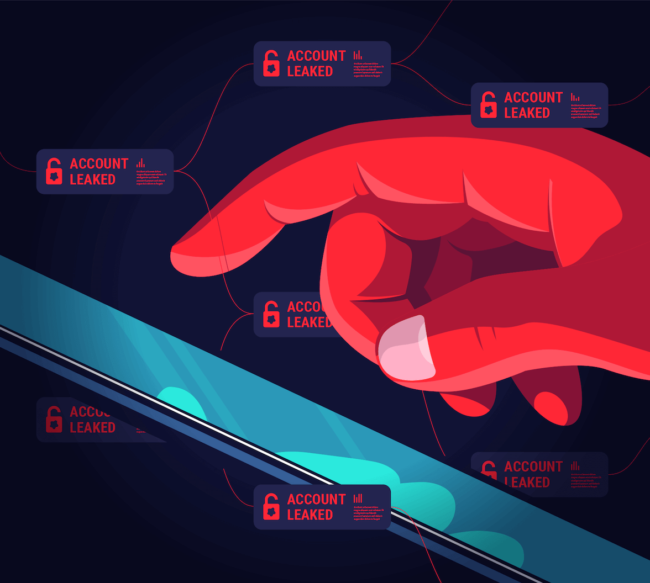
Real example of SE
Real example of SE
Real example of SE
Real example of SE
Real example of SE

Slide 7
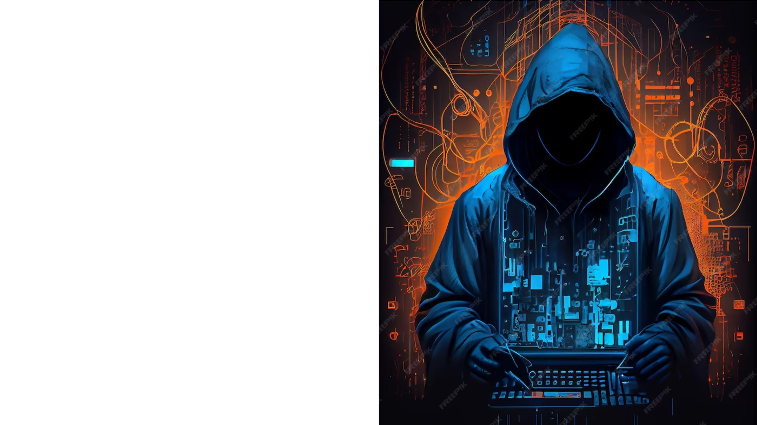
Prevention & Safety awareness from Malware

Slide 8
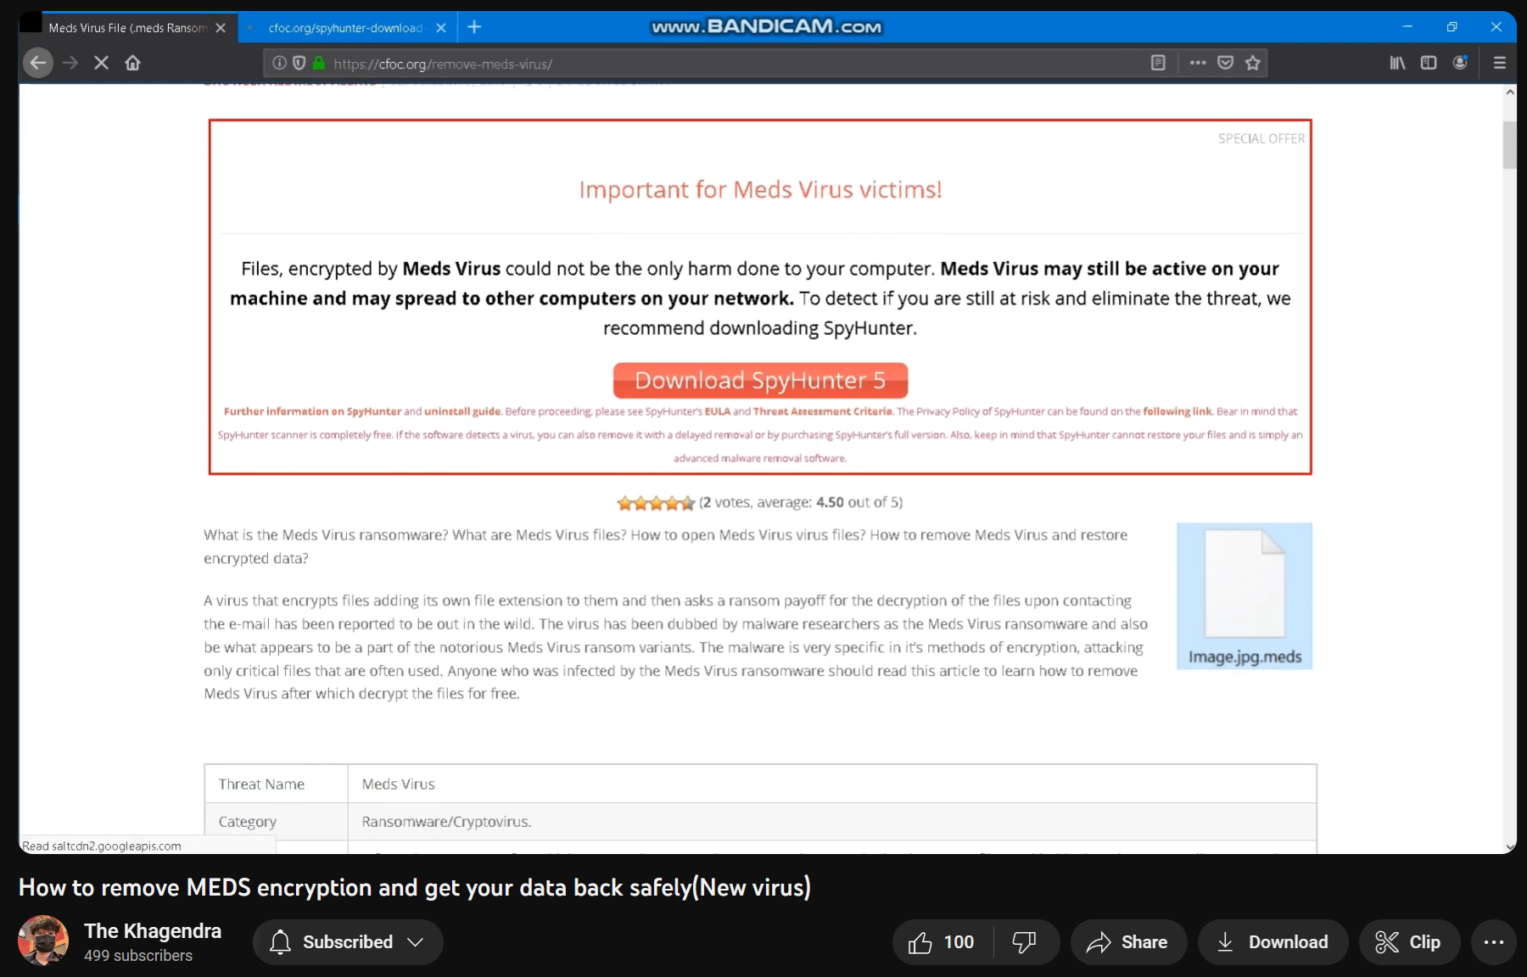

Slide 9


Slide 10
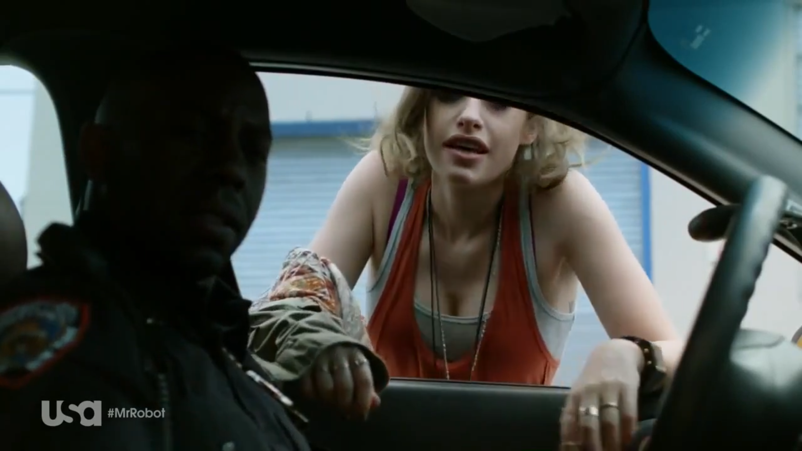
Figure out suspicious activity!

Slide 11
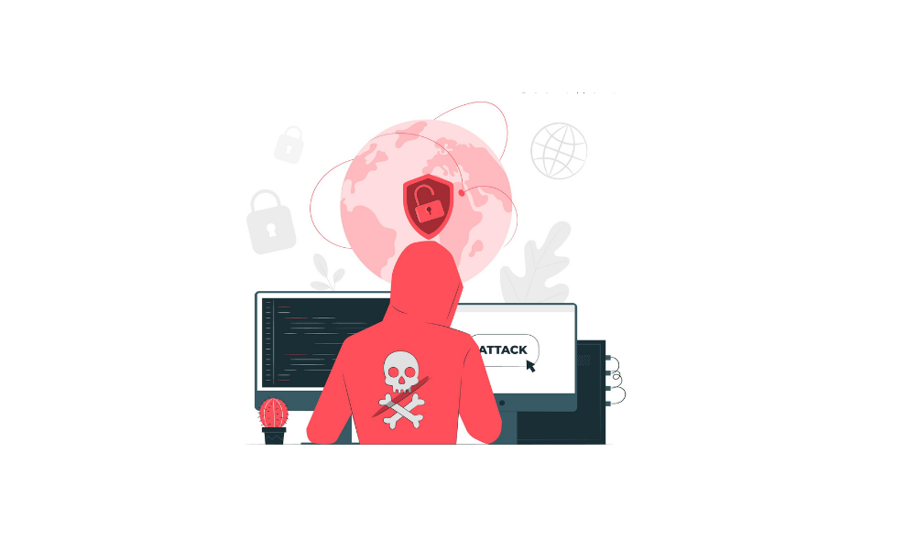
Method 2
Method 1
Prevention from Social Engineering Attacks

Slide 12
Conclusion

Slide 13
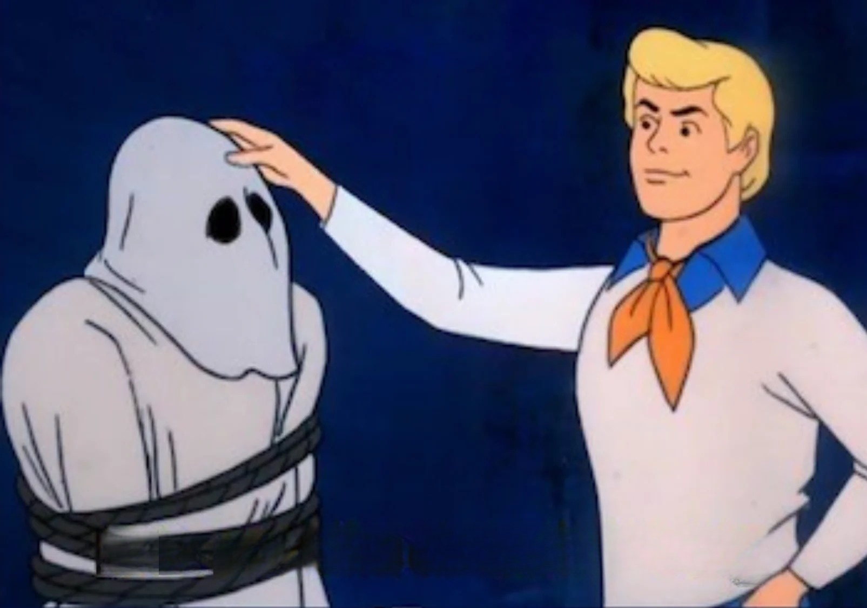

Slide 14
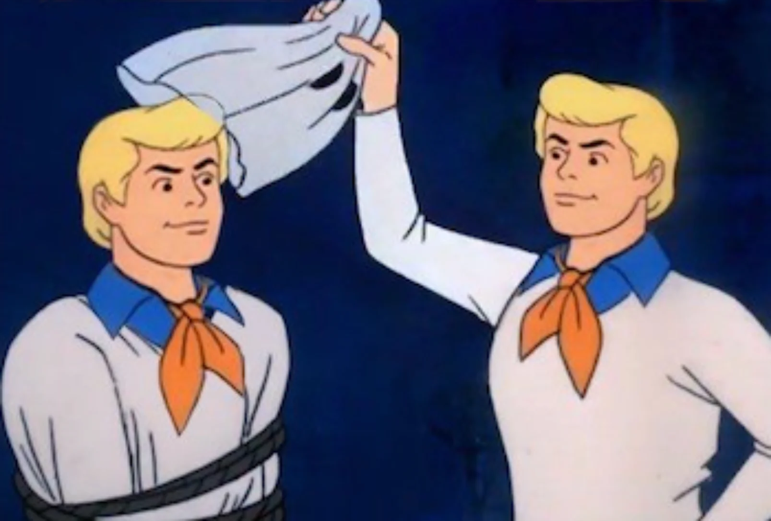

Slide 15


